Slide 1




API Method Recommendation via Explicit Matching of Functionality Verb Phrases
Wenkai Xie¹, Xin Peng¹, Mingwei Liu¹, Christoph Treude²,
Zhenchang Xing³, Xiaoxin Zhang¹, Wenyun Zhao¹
¹Fudan University , China
²The University of Adelaide, Australia
³Australian National University , Australia
Notes:
Hi, every one. My name is Mingwei Liu. Currently, I conduct my post doctoral research in Fudan University. Today, I are glad to present our work: “API Method Recommendation via Explicit Matching of Functionality Verb Phrases

Slide 2



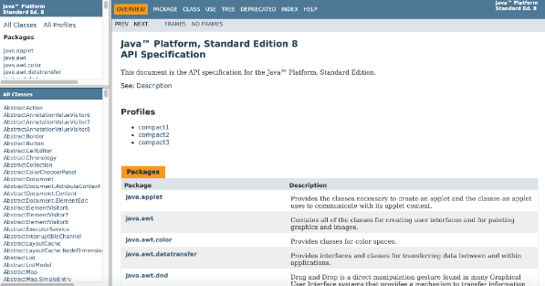
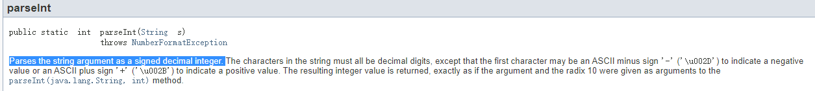
Scenario
how do I convert a String to int
User Query
Lexical Gap
Parses the string argument as a signed decimal integer
Functionality Description
java.lang.Integer.parseInt(String)
Documentation based API Retrieval
Due to the lexical gap, documentation based API retrieval using lexical similarity often produces poor results.
Notes:
Developers often need to find some APIs with specific functionalities. In this situation, they often rely on documentation based API retrieval approaches, For example, developers need to find an API with the user query “how do I convert a String to int”, which is the blue one. The green one the corresponding API from JDK with functionality description from API documentation. As we can see, there are some gaps between the user query and the functionality description. They use different verbs to describe the functionalities and different terms to describe the concepts involved. Due to the lexical gap, documentation based API retrieval using lexical similarity often produces poor results.

Slide 3
Challenge
Verb Gap
convert
parse
turn
transform
change
Different verbs are used to express the same functionality
Notes:
In fact, different gaps could exist between the user query and functionality descriptions. The first one the verb gap. Different verbs are used to express the same functionality. For example conver、change，turn,parse, transform could be used to describe the functionality about transforming something to other forms

Slide 4
Challenge
Verb Gap
return a list from an array
return the size
The same verb is used to express different functionalities
Notes:
On the other hand, the same verb is used to express different functionalities, the return has different meanings in return the size and return a list from an array.

Slide 5
Challenge
Phrase Patten Gap
convert an array to a list
return a list from an array
Different phrase patterns are used to express the same functionality
Notes:
Another gap is the phrase gap. Different phrase patterns are used to express the same functionality
. For example , convert an array to a list. And return a list from an array
.

Slide 6
Challenge
Phrase Patten Gap
convert an array to a list
convert a list to an array
The role of each component playing in the pattern is essential for the semantics
Notes:
Moreover, The role of each component playing in the pattern is essential for the semantics. For example, the yellow and red sentences describe opposite functionalities by using the same words. “convert A to B” is not the same as “convert B to A” because A and B play different roles in the patterns.

Slide 7
Challenge
Term Gap
Terminates the currently running Java Virtual Machine
How do you crash a JVM?
Java Virtual Machine
JVM
Different terms are used to express the same meaning
Notes:
The last gap is the term gap. Different terms could be used to express the same meaning. Some background knowledge are needed to bridge the gap. For example, How do you crash a JVM is matching with Terminates the currently running Java Virtual Machine because JVM is an alias of Java Virtual Machine.

Slide 8



Idea
Verb phrases and their phrase patterns are essential in describing the functionality of API methods and interpreting user queries.
match user query and functionality description
by lexical similarity
by semantics of functionality verbs and phrase patterns
Notes:
Our idea is that verb phrases and their phrase patterns are essential in describing the functionality of API methods and interpreting user queries. We should match functionality description and user query in terms of functionality verbs and phrase patterns, according to the semantics they express rather than their lexical similarity.

Slide 9
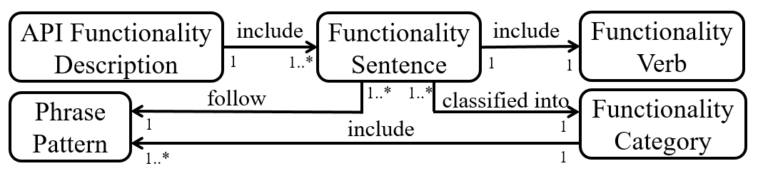
Terminology Model
Example
Functionality Sentence (f_sentence): This operation converts a Stringfield Name into an equivalent array of NameComponents
Functionality Verb (f_verb): convert
Functionality Category (f_category): “convert/transform/parse” f_category, defined as “transform something into other forms”
Phrase Pattern (p_pattern): V {source} to/as/into {goal}
Notes:
We define the main concepts and relationships used for the explicit modeling of API functionality descriptions.
The slide also show some examples for defined concepts. The reference documentation contains for each API method a description of its main purpose, that is API functionality description. The functionality description may include several sentences that describe the functionalities of the method, which we call functionality sentences . Each functionality description may include several verbs or verb phrases. Only one functionality verb denotes the main action of the functionality, for example , convert. A functionality sentences can be classified into a functionality category. based on the meaning of its functionality verb in the current context. A functionality category could include some phrase patterns used to describe the specific type of functionality. For example, V source to goal.

Slide 10

Empirical Study
RQ1: What verbs are used in the API functionality sentences?
RQ2: What functionality categories can the functionality sentences be classified into?
RQ3: What phrase patterns are used in the functionality sentences from each functionality category?
Notes:
To understand what functionality verbs, phrase patterns, and functionality categories are present in API functionality sentences, We conducted an empirical study. Specifically, we focus on answering the following research questions. We focus on JDK and Android APIs based on their reference documentation.

Slide 11
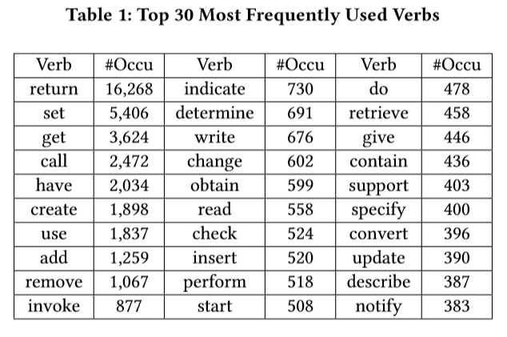
Verb Analysis Results (RQ1)
Identify verbs in 54,256 f_sentences by Spacy
931 different verbs
Most verbs are not domain specific! They could occur in other libraries from different domains.
Top 30 verbs are not domain specific
Notes:
“Return” is by far the most used verb, followed by “set” and “get”. These are not surprising, based on our experience with the code and documentation. An interesting observation is that these top 30 verbs are not domain specific, which implies that we expect them to occur in other libraries, from different domains ,as well. Weinspectedalltheverbs

Slide 12
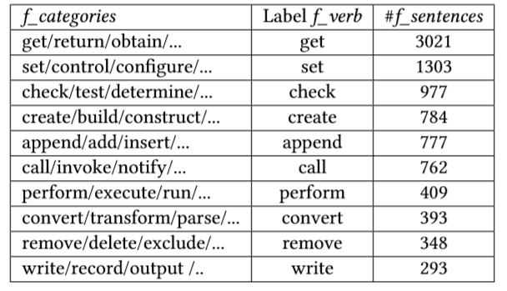
Functionality Categories (RQ2)
We identified 87 f_categories with 356 f_verbs by coding on 14,774 f_sentences.
A f_category contains 4.7 f_verbs on average (median 2.5).
30 f_categories (34.5%) contain a single f_verb.
34 f_verbs appear in a multiple f_categories (e.g., “give” for four f_categories).
Functionality sentences of JDK and Android could classified into a limited set of 87 f_categories. Most f_categories are quite common and could be reused by many other libraries.
Notes:
有限的功能类别可以。覆盖大部分的功能描述。找一找introduction。

Slide 13
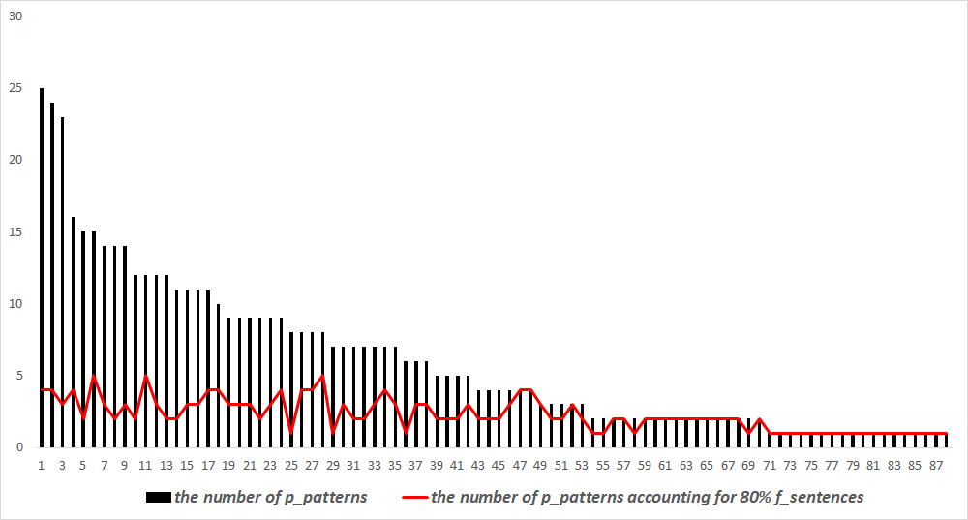
Phrase Patterns (RQ3)
We identify 523 phrase patterns.
The number of p_patterns for each f_categories varies between 1 and 25 (mean 6, median 4).
For all the f_categories 80% of the f_sentences are described by 1-5 p_patterns (mean 2.3, median 2).
The identified p_patterns have 0-4 semantic roles. Most of them (73%) have one or two semantic roles.
the number of p_patterns covering 80% of the f_sentences
Most f_sentences could be described by few simple p_patterns
Notes:
有限的功能类别可以。覆盖大部分的功能描述。找一找introduction。

Slide 14

Empirical Study Conclusion
Most of the JDK and Android API functionality sentences can be classified into a limited set of 87 functionality categories with 1-5 phrase patterns used for each functionality category.
Notes:
As a result, we found that Most of the JDK and Android API functionality sentences can be classified into a limited set of 87 functionality categories with 1-5 phrase patterns used for each functionality category. More details could be found in our paper.

Slide 15
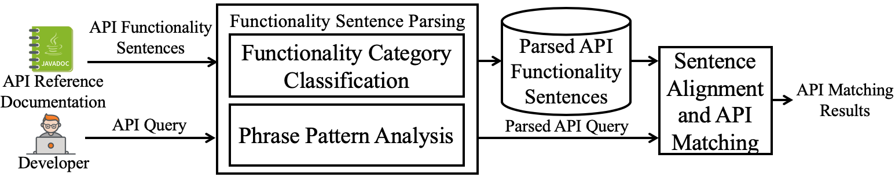
Overview for PreMA
Notes:
Based on the empirical study results, we propose an approach PreMA for matching of API functionality descriptions to recommend API method. This slide shows the overview of our approach, Given functionality sentences from API reference documentation, the approach parses the sentences by analyzing their functionality_categories and phrase_patterns. The parsed functionality_sentences are then stored for further analysis. When used for API searching, PreMA parses the API query issued by the developer in a similar way. It then matches the parsed API query with the parsed functionality_sentences by aligning them based on functionality_categories and phrase_patterns. The API matching results include completely or partially matched APIs and their functionality_sentences, together with explanations of the matching.

Slide 16
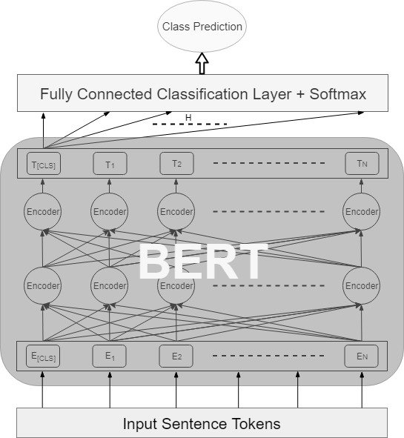
Functionality Category Classification
one of 87 functionality categories or the category “Unknown”
functionality sentence or a query
BERT-based Text Classification Model
Notes:
The first step is the functionality category classification, for a functionality sentence or a user query, we use BERT-based classifier to classify it into one of the 87 functionality categories or the category unknown. The training data are from our empirical study and additional annotation.

Slide 17
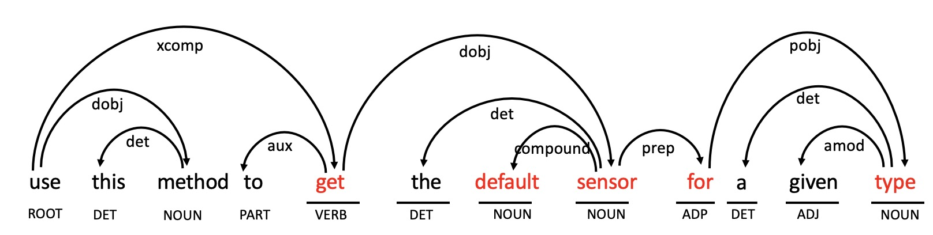
Phrase Pattern Analysis
functionality category “get/return/obtain”
Input: sentence, functionality category
sentence “use this method to get the default sensor for a given type”
POS tagging and dependency parsing by Spacy
Traverse dependency tree in preorder and identify functionality verb in the sentence by matching the verb traversed with candidate functionality verbs of corresponding category in order
candidate functionality verbs:
Get
Return
Obtain
…
the first traversed verb
use
functionality verb: get
the second traversed verb
get
Notes:
For the phrase pattern analysis, the input is the sentence and its functionality category. First we conduct the POS tagging and dependency parsing by NLP tool Spacy , then we traverse dependency tree in preorder and identify functionality verb in the sentence by matching the verb traversed with candidate functionality verbs of corresponding category in order. As shown in the slide,the sentence has two verbs such as use and get. We identify get as the functionality verb based on the functionality category get.

Slide 18
Phrase Pattern Analysis
fuctionality category “get/return/obtain”
sentence “use this method to get the default sensor for a given type”
identify core clause
extract syntactic pattern
obtain all phrase patterns of the functionality category as candidates
core clause:
get the default sensor for a given type
syntactic pattern:
V NP for NP
find the phrase pattern closest to the syntactic pattern among the candidate phrase pattern
phrase pattern:
V{patient} for {beneficiary}
candidate patterns:
V{patient}
V{patient} for {beneficiary}
…
Notes:
After that, we identy the core clause in the sentence, which is the subtree of functionality verb.The Then we extract the syntactic pattern of the core clause, For V NP for NP is the syntactic pattern of the get the default sensor for a given type. We further obtain all phrase pattern of the functionality category as candidates and find the phrase pattern closest to the synaptic pattern among all candiates as the phrase pattern of the sentence.

Slide 19
Sentence Alignment and API Matching
Parsed API Query Q
Matching Score Calculation
API Method Ranking
Explanation Generation
Parsed F_sentences FSs
F_category Similarity
Q and FS are classified into the same f_category
Sim_{C}(Q, FS) = 1
Q and FS are classified into the different f_category
Sim_{C}(Q, FS) = 0
Notes:
For the sentence alignment and API matching, we match the parsed API query Q and functionality sentence FS to return ranked API list with explanations. The explanation describe how each API match with the user on functionaliy category and phrase pattern.
This part includes three steps., matching score calculation, API method ranking and explanation generation.
Match score calculation between user query and functionality description is the most important steps.
First it considers the simlilary between their functionality category.

Slide 20
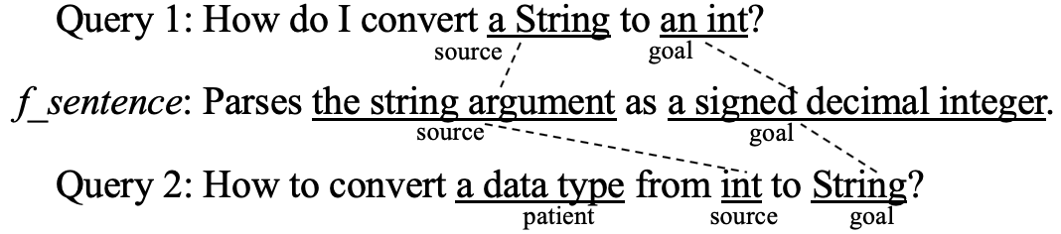

Sentence Alignment and API Matching
Parsed API Query Q
Matching Score Calculation
API Method Ranking
Explanation Generation
Parsed F_sentences FSs
Semantic Role Similarity
Entity Alignment
Entity Link
Entity Matching
Match(E_{Q} ,E_{FS})=1 if E_{Q} and E_{FS} are same entity or have a hyponymy relations;
Match(E_{Q} ,E_{FS})=0, otherwise.
Sim_{R} (Q,FS) is calculated by summing the matching scores of all the aligned entity pairs between Q and FS
int
integer data type
signed decimal integer
Notes:
Then it considers the semantic role similarity by entity alignment, entity linking and entity matching.

Slide 21
Sentence Alignment and API Matching
Parsed API Query Q
Matching Score Calculation
API Method Ranking
Explanation Generation
Parsed F_sentences FSs
Text Similarity
Preprocessing
Sentence Vector Generation
Q
convert
String
int
normalized cosine similarity between the vectors of Q and FS
parse
argument
String
FS
signed
decimal
integer
Text Vector Space
Notes:
It also consider the text similary between them.
In this way, we find API based on the explicitly matching on the functionality description, not just simple text similarity,

Slide 22
Accuracy of Functionality Sentence Parsing
Accuracy
F_category Classification. We used 14,774 f_sentences annotated in the empirical study to do a 5 fold cross validation. The average accuracy on the test set is 92.8% (with 92.6% minimum accuracy).
P_pattern analysis. We used the remaining 11,074 f_sentences (after removing sentence belonging to the “Unknown” f_category) and their annotated p_patterns as the test set. The results show that the accuracy of the p_pattern analysis is 90.4%.
PreMA achieves high accuracy on functionality sentence parsing
Generalization
We randomly selected 100 f_sentences from the POI reference documentation and annotate their f_categories and p_patterns as the ground truth. f_category classifier trained on all annotated sentence achieved the accuracy of 97%. P_pattern analyzer achieved the accuracy of 95%.
f_category classifier and the p_pattern analyzer trained on JDK and Android reference documentation also work well for other libraries
Notes:
We evaluate our approach with several experiments. First, we evaluate the accuracy of functionality sentence parsing on some human annotated dataset. The results show that preMa PreMA achieves high accuracy on functionality sentence parsing. Further, our functionality_category classifier and the phrase pattern analyzer trained on JDK and Android reference documentation also work well for other libraries.

Slide 23
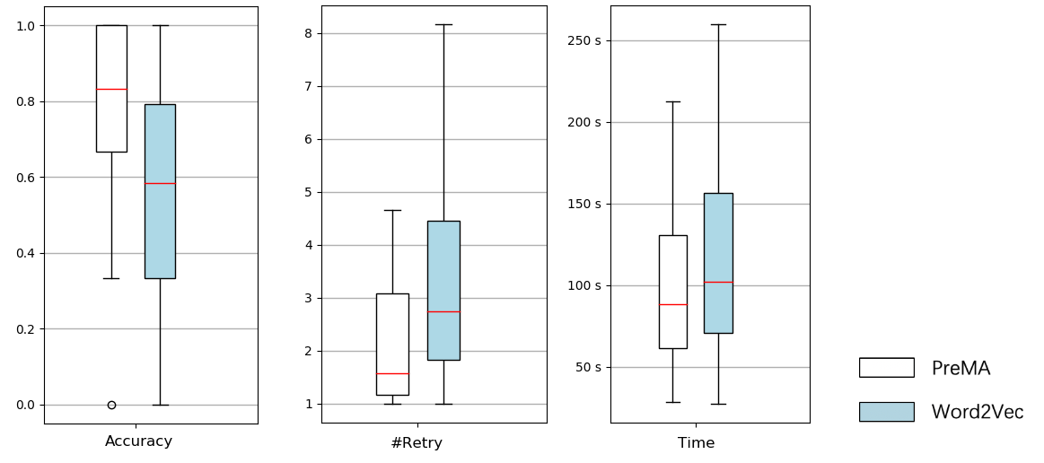
Performance of API Method Retrieval
Ask participants to complete 30 API retrieval task with PreMA or a baseline based on Word2vec
Participants using PreMA completed the tasks more accurately, required fewer retries, and used less time than those using the baseline tool.
Notes:
Ask participants to complete 30 API retrieval task with PreMA or a baseline based on Word2vec
Participants using PreMA completed the tasks more accurately, required fewer retries, and used less time than those using the baseline tool.

Slide 24
Conclusion
We conducted a large-scale empirical study on the functionality descriptions of 14,733 JDK and Android API methods. As a result, we identified 87 functionality categories with 356 different functionality verbs and 523 phrase patterns.
Building on these findings, we propose an API method recommendation approach, PreMA, based on explicit matching of functionality verb phrases in functionality descriptions and user queries.
Feel free to contact me: liumingwei@fudan.edu.cn
Working on open source: https://github.com/FudanSELab/funcverbnet
Replication package: https://fudanselab.github.io/Research-FSE2020-FuncVerb/
Notes:
1. extractive, we extract most relevant methods and sentences for API
2. on-demand, we accept a user textual query, which describe the programming task at hand.
3. query-specific, we will generate Different Summaries of the Same Class for Different Queries.
4. Our summary is generated based

Slide 25

THANKS
Postdoc at Software Engineering Lab,
Fudan University Any job opportunity is welcome!
Email: liumingwei@fudan.edu.cn
Homepage: https://mingwei-liu.github.io/

